Slide 1
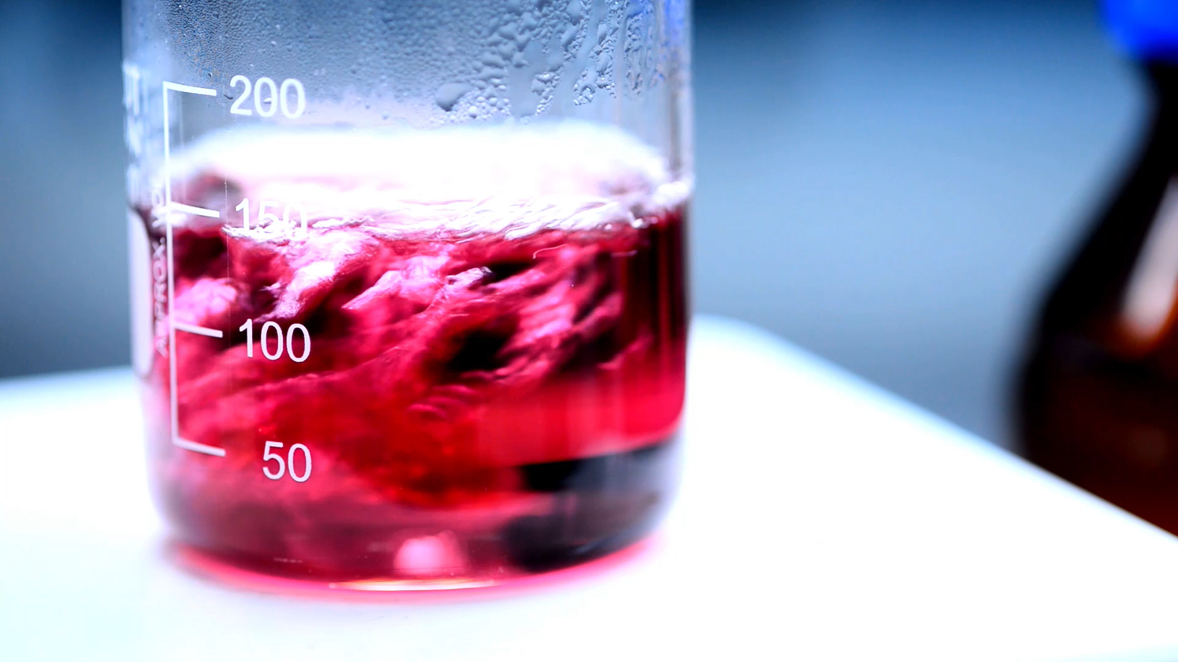
Red Wine Quality Analysis
Quality Feature Analysis

Slide 2
Red Wine Break Down - Agenda
Fixed Acidity, Volatile Acidity, Citric Acid – Rebekkah Alexander
Residual Sugar & Alcohol – Danita Charles
Free Sulfur Dioxide & Total Sulfur Dioxide – Bryan Thomas
Density & pH – Aaron Wood
Sulphates & Chlorides – Barry Maldonado

Slide 3
Fixed Acidity, Volatile Acidity, Citric Acid
Rebekkah Alexander

Slide 4
Acidity in Wine
Fixed Acidity
Volatile Acidity
Citric Acid
Tartaric Acid
Malic Acid
Citric Acid
Acetic Acid
Ethyl Acetate
Found naturally in grapes
Adds tangy and slightly citrus flavors
Adds crispness, balance and refreshing character
Small amounts add complexity and bright, tangy notes
Excessive amounts lead to sour, vinegary wine that smells like nail polish remover
Measured in Grams per Liter (g/L)
Notes:
Fixed Acidity
- Non-Volatile acids - Non easily evaporated acids
- Tartaric Acid
- Malic Acid - Most significant in wine due to stability and resistance to microbial spoilage
- Citric Acid
- Taste
- Gives crispness, balance and refreshing character
- Balance
- Balances sweetness, alcohol and tannins
- Preservation
- Natural antimicrobial ensuring stability during aging
- Wines with too little may taste flat or lifeless
- Wines with too much may taste sour or harsh
- GRAMS PER LITER (g/L)
Volatile Acidity
- Volatile Acids - Easily evaporated acids
- Acetic acid - Responsible for sourness in vinegar
- Ethyl Acetate - Often smells like nail polish remover
- Smell
- Small amounts add complexity and bright, tangy notes
- Flavor
- Acceptable amounts contribute to perceived freshness and balance
- Faults
- Excessive amounts lead to sour, vinegary wine
- Acceptable amounts
- Red - 1.2g per liter
- White - 1.1g per liter
- Causes of high amounts
- Microbial activity - uncontrolled yeast or bacteria
- Poor hygiene - contamination
- Aging - Overexposure to oxygen during barrel aging can encourage production
- Control
- Aeration Control - minimizing oxygen during fermentation and aging
- Sulfur Dioxide(SO2) - inhibit microbial growth
- Hygiene Practices - Maintaining clean equipment
- Low amounts may lack aroma complexity and character, often found in clean, modern winemaking styles
- Moderate amounts add brightness and complexity
- High amounts overwhelm the wine with vinegar or acetone aromas, considered fault if this happens
- GRAMS PER LITER (g/L)
Citric Acid
- Origin in Grapes
- Citric acid occurs naturally but usually less then .5% of the total acid content
- Not a major acid but contributes to overall acid balance
- Taste
- Adds tangy and slightly citrus like flavor to wine
- More noticeable in wines lower in tartaric or malic acid
- Balance
- Balances sweetness
- Stabilization
- Natural Preservative
- See Fixed Acidity
- GRAMS PER LITER (g/L)

Slide 5
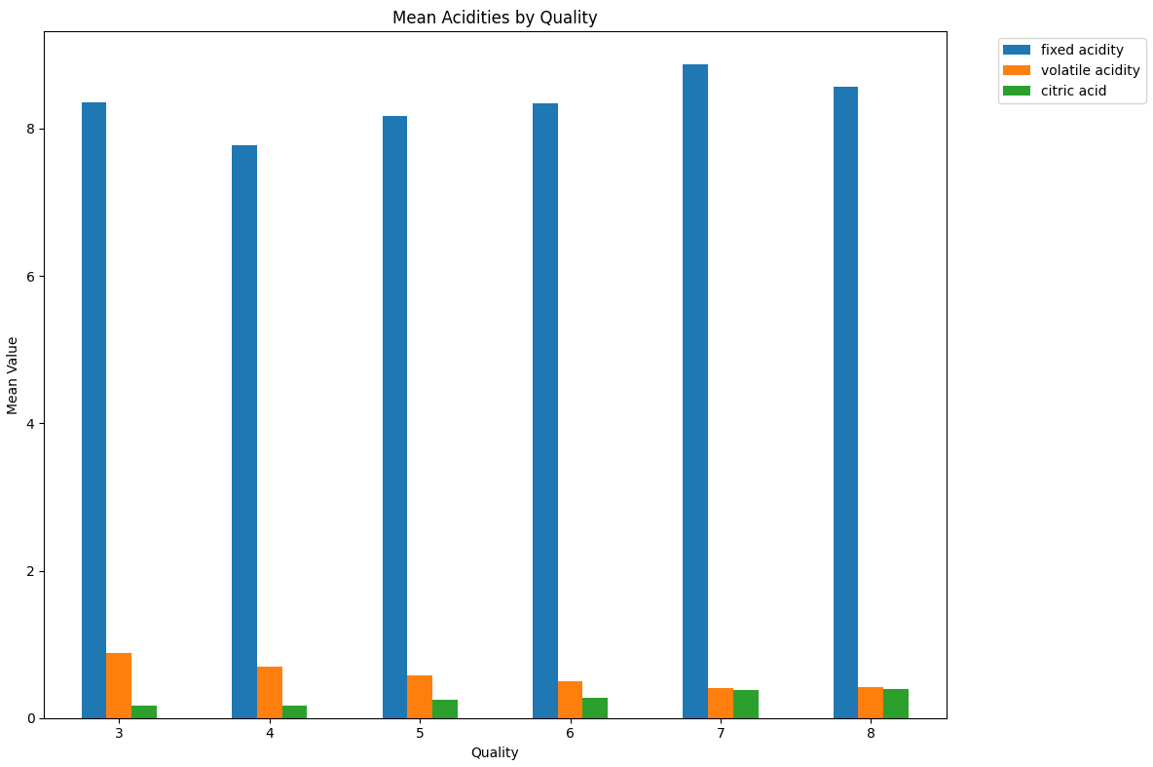
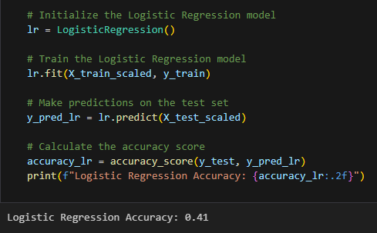
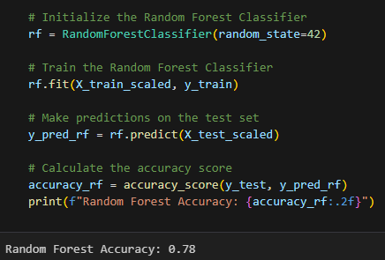
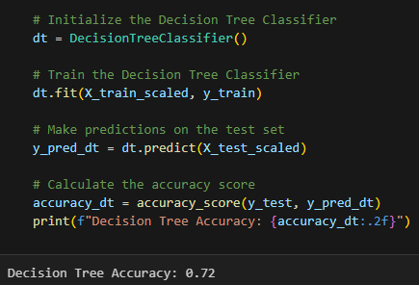
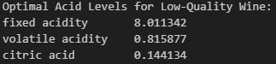
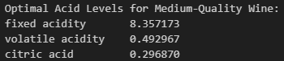
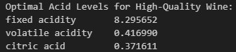
Analysis
Logistic Regression: 41% Accuracy
Decision Tree: 72% Accuracy
Random Forest: 78% Accuracy
SMOTE
Creates synthetic data to balance out class imbalances

Slide 6
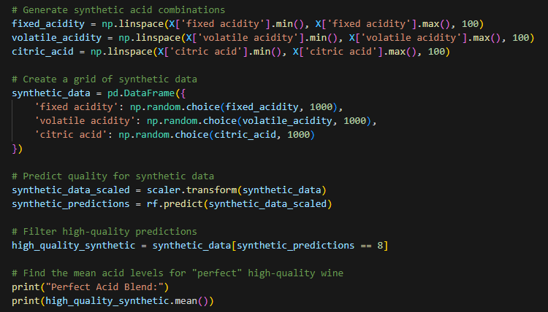
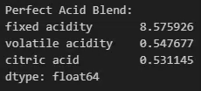
Synthetic Testing
Creates 1000 points of synthetic data based off the data provided
Tests that data with the trained Random Forest model
Every time the code is ran; it will output slightly different results because it works with synthetic data based off the data it is provided.

Slide 7
Residual Sugar & Alcohol
Danita Charles

Slide 8
Wine Residual Sugar & Alcohol Content
Do the physicochemical properties residual sugar and alcohol level contribute to specific quality scores of red wine?
Residual sugar levels range 0.9(low)-15.5(high)
Alcohol level range 8.4(low)- 14.9(high)
Quality level range 3(low)-8(high)

Slide 9
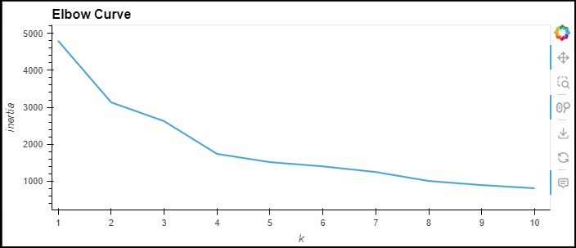
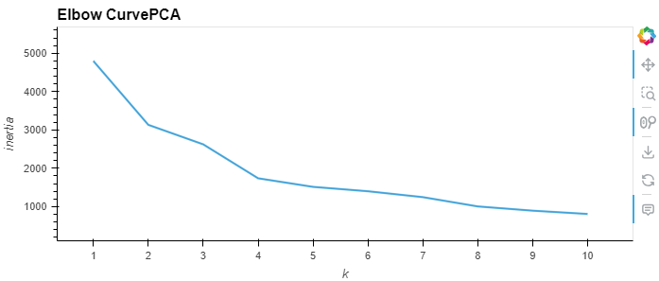
Unsupervised Cluster Analysis
Kmeans
Optimized with PCA

Slide 10
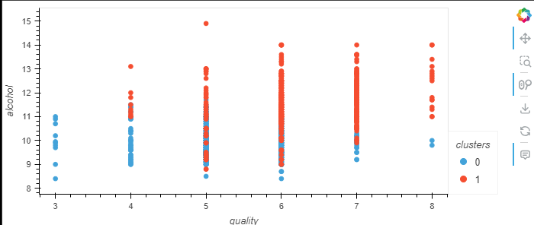
Alcohol Content
Alcohol content levels 9% -12% are more associated with red wine quality level 6.

Slide 11
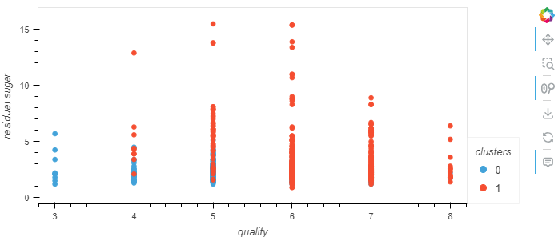
Residual Sugar
Residual sugar levels 1-5 are more associated with quality level 6

Slide 12
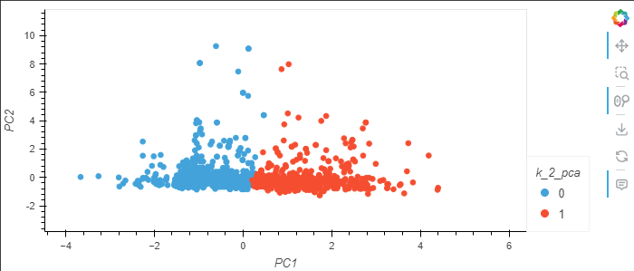
Residual Sugar & Alcohol Content Combined
Optimized Cluster Analysis using Principal Component Analysis (PCA)
Mid levels residual sugar 6-7 combined with alcohol content (10-12) associated with high quality 6-7.

Slide 13
Free Sulfur Dioxide & Total Sulfur Dioxide
Bryan Thomas

Slide 14
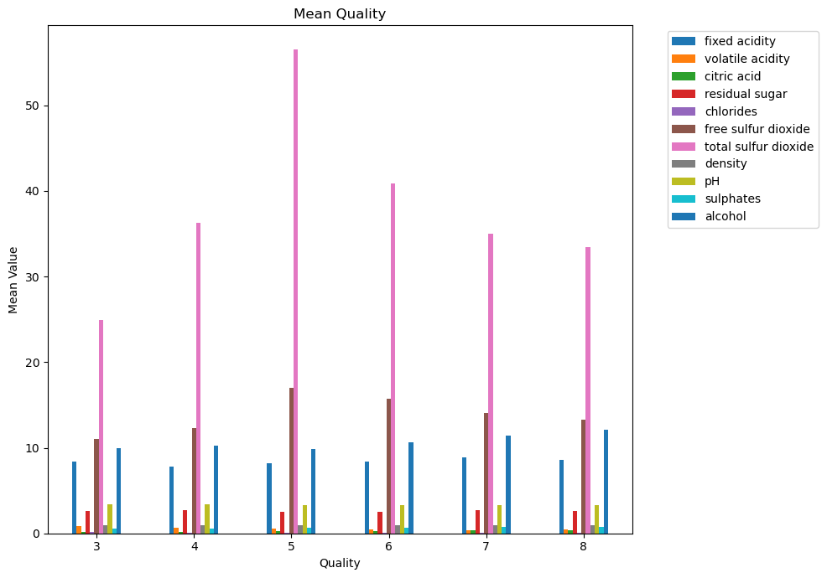
Wine Free & Total Sulfur Dioxides

Slide 15
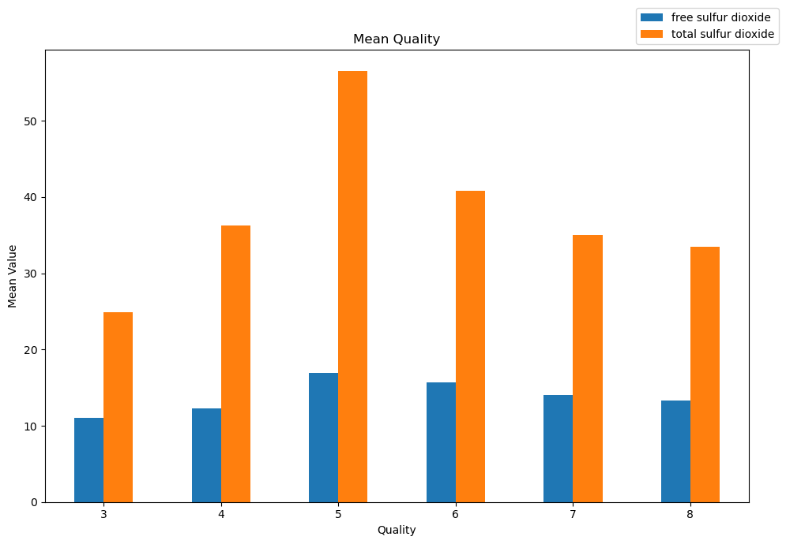
Wine Sulfur Dioxide Content

Slide 16
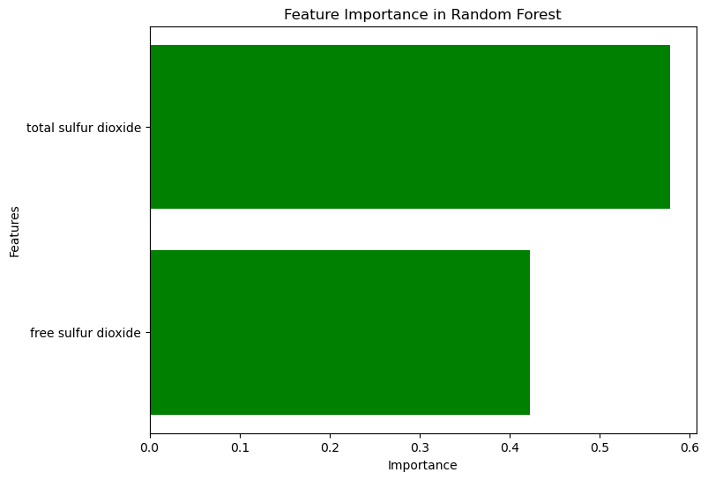
Sulfur Dioxide Importance

Slide 17
Density & pH
Aaron Wood

Slide 18
Wine Density & pH
Aaron Wood
Wine density refers to the amount of dissolved solids (e.g. – sugars) dissolved in the wine. Dryer wines have lower densities than sweeter wines.
Wine pH refers to the acidity of the wine. Wine pH will impact the taste, color, and aging of the wine.

Slide 19
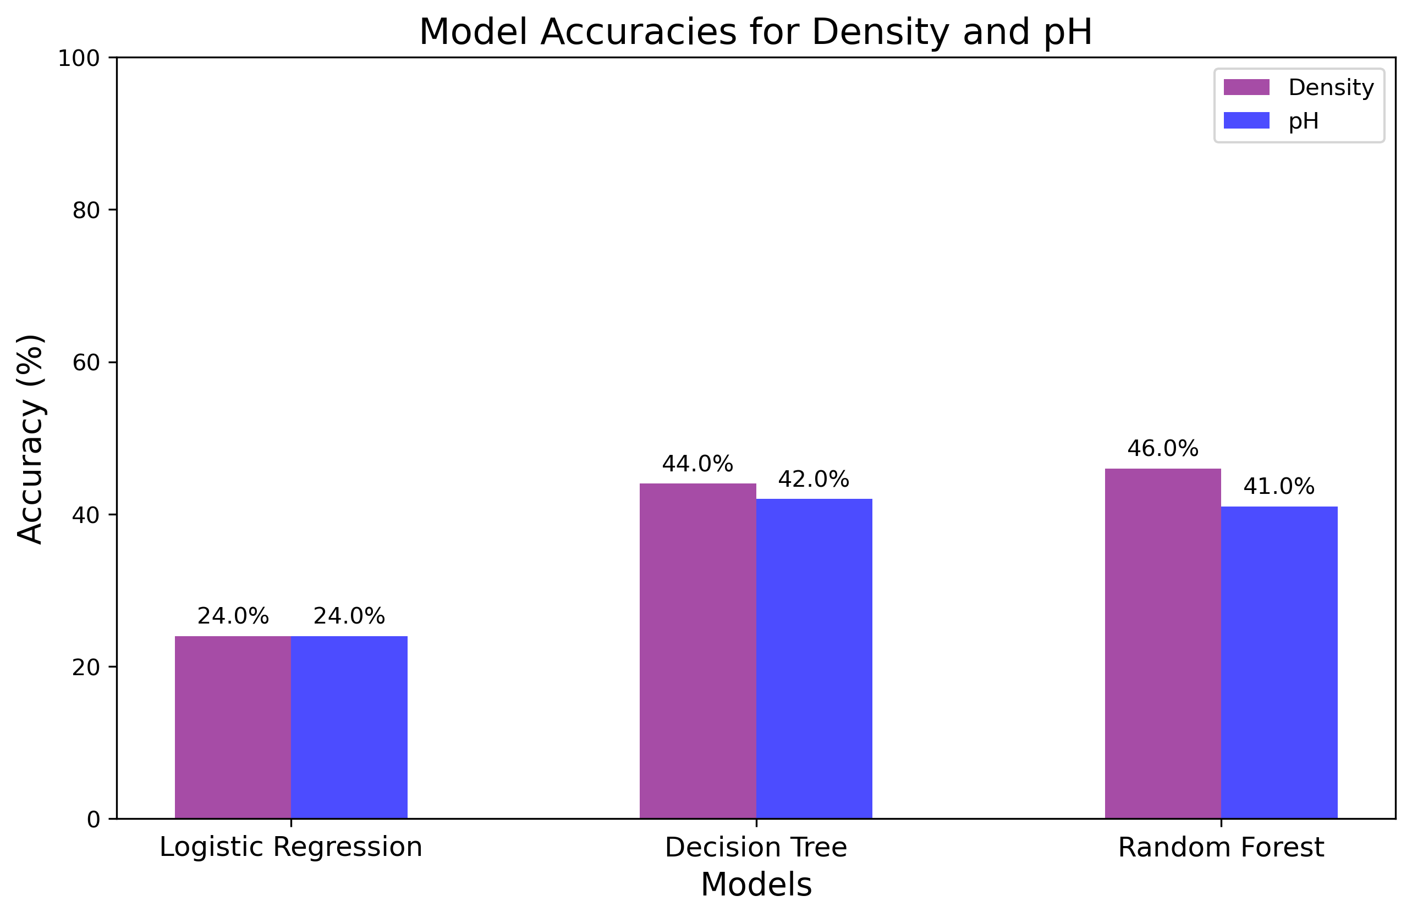
Accuracy Issues

Slide 20
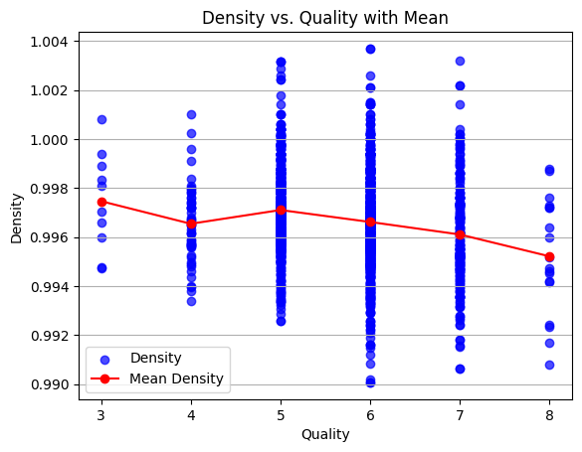
Wine Density
Modeled density for quality wine is .9948 g/mL.
Logistic Regression accuracy is 24%.
Decision Tree accuracy is 44%.
Random Forest accuracy is 46%.
Wine density is NOT an appropriate measure for predicting wine quality. Sufficient accuracy could not be obtained by the models targeting standalone physiochemical density and the mean may be just as useful within the density data
Notes:
quality
3 0.997464
4 0.996542
5 0.997104
6 0.996615
7 0.996104
8 0.995212

Slide 21
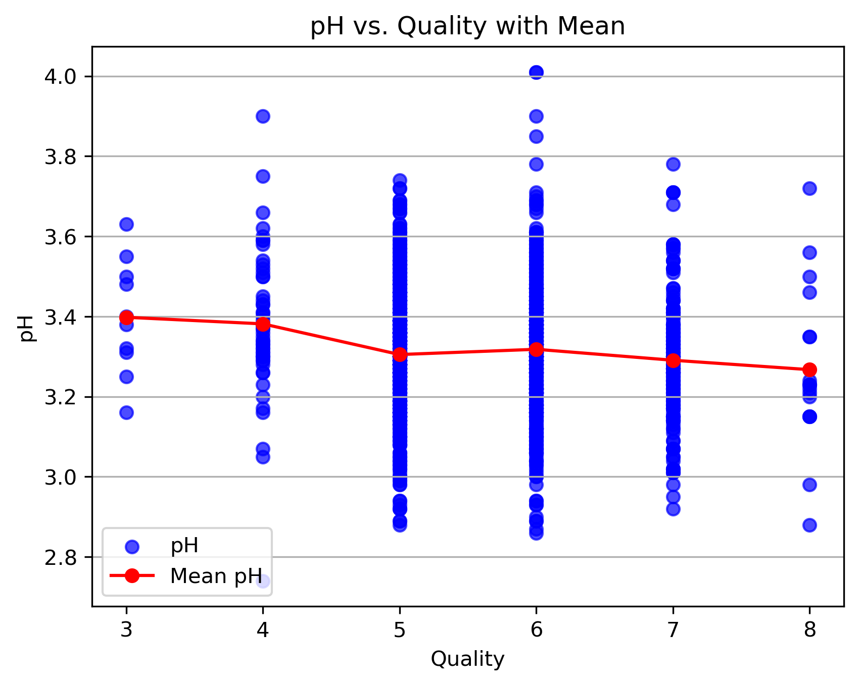
Wine pH
Modeled pH for quality wine is 3.26.
Logistic Regression accuracy is 24%.
Decision Tree accuracy is 42%.
Random Forest accuracy is 41%.
Wine pH is NOT an appropriate measure for predicting wine quality. Sufficient accuracy could not be obtained by the models targeting standalone physiochemical density and the mean may be just as useful within the pH data.
Notes:
quality
3 3.398000
4 3.381509
5 3.304949
6 3.318072
7 3.290754
8 3.267222

Slide 22
Sulfates & Chlorides
Barry Maldonado

Slide 23
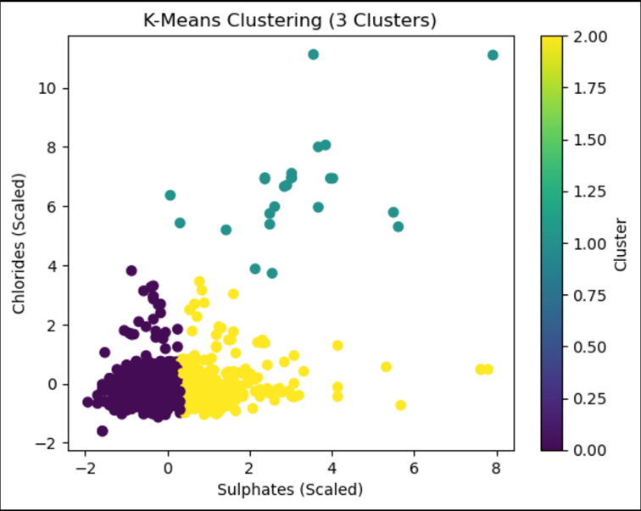
Wine Sulfates & Chlorides
Key Findings:
1. Clustering Results:
- Cluster 1: Highest average quality (6.06), associated with moderate Sulphates and Chlorides.
- Cluster 0: Intermediate quality (5.48), balanced feature values.
- Cluster 2: Lowest average quality (5.29), driven by high Sulphates and very high Chlorides.
2. Feature Importance:
- Sulphates contributed significantly to the prediction of wine quality, positively impacting quality in moderate ranges.
- Chlorides had a smaller influence, negatively impacting quality when values were high.
3. Supervised Model Performance:
- Initial Model Accuracy: Approximately X% (replace with actual score).
- Tuned Model Accuracy: Improved to Y% (replace with actual score).
- Classification Report: Showed consistent performance across wine quality categories, with room for improvement in extreme cases.

Slide 24
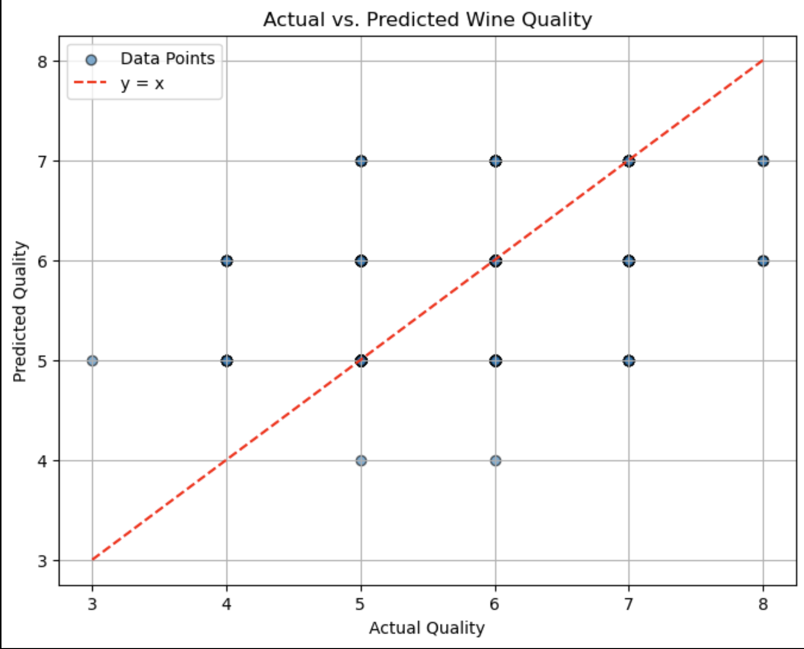
Wine Sulfates & Chlorides
Recommendations For Winemakers:
- Maintain moderate Sulphates and minimize Chlorides to enhance wine quality.
Future Work:
- Incorporate additional physicochemical features (e.g., acidity, alcohol content) for a comprehensive analysis.
- Explore DBSCAN for more flexible clustering to detect noise or outliers.
Model Refinement:
- Continue hyperparameter tuning and consider ensemble methods for improved prediction accuracy

Slide 25
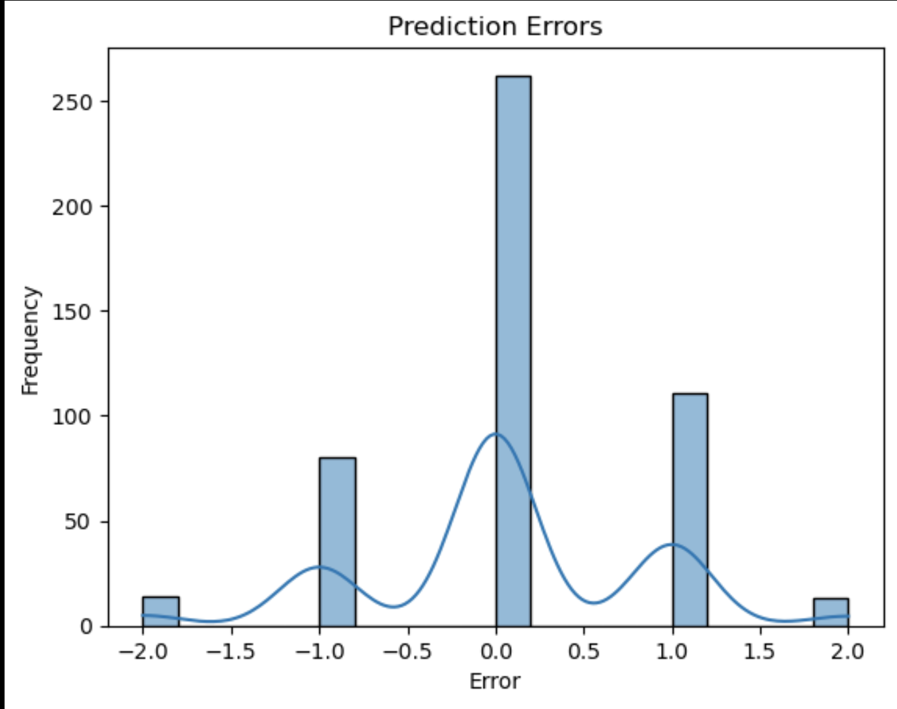
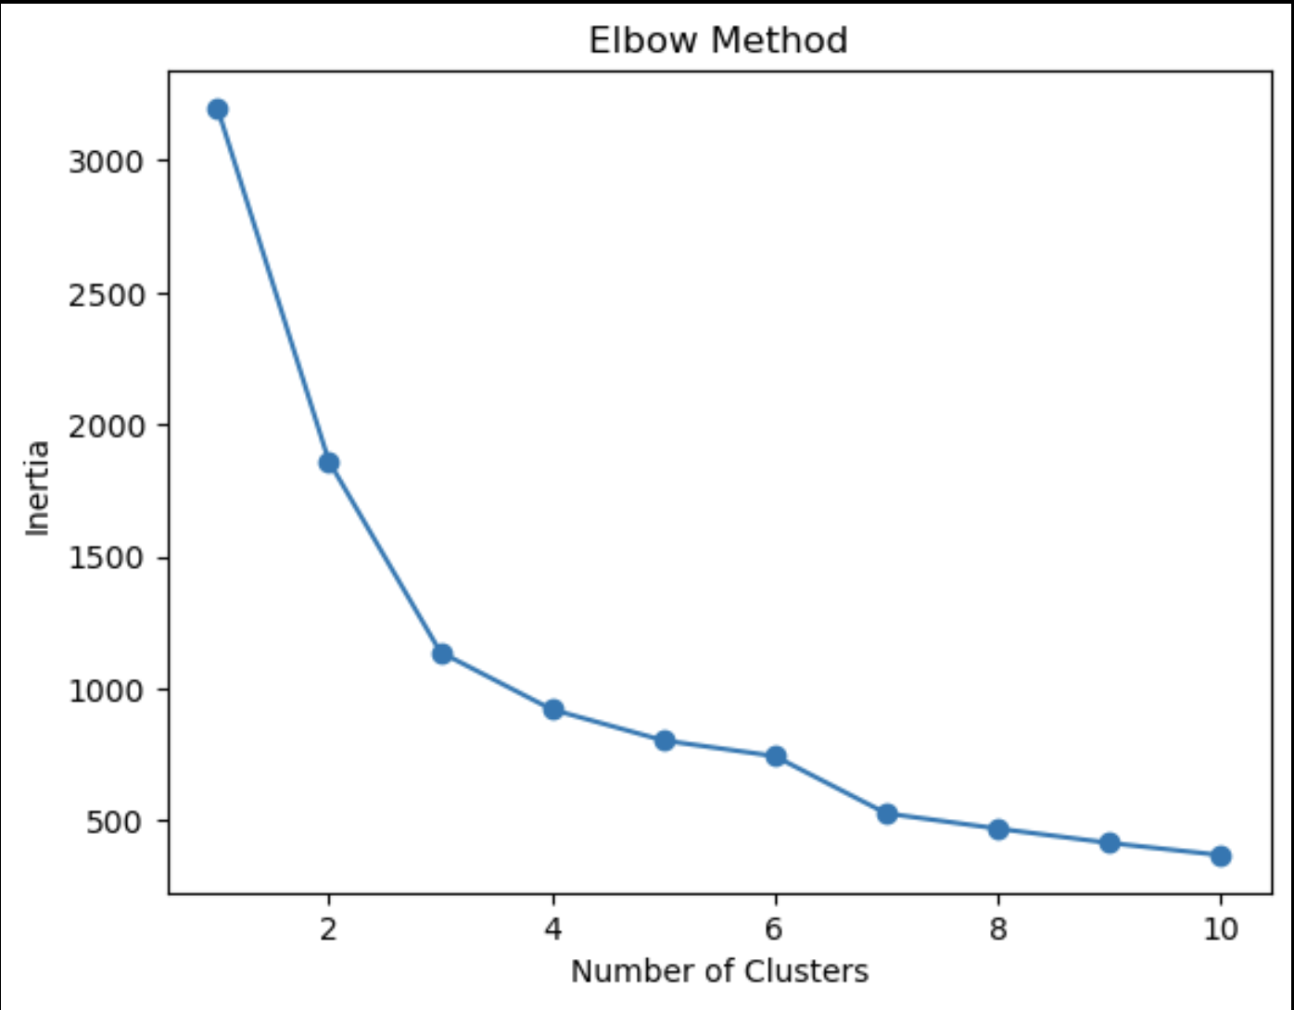
Wine Sulfates & Chlorides

Slide 26
Questions?

Slide 27
Thank you!

